Slide 1
MSDS 6371: Unit 1
Quiz Solutions

Slide 2
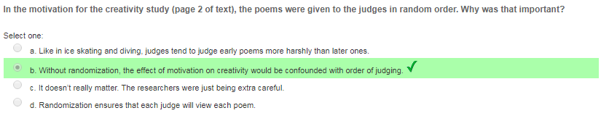
Questions 1 & 2
Issues such as judging fatigue and using the first few poems as benchmarks could affect the scoring. Therefore, randomly ordering the poems for each judge individually spreads out these factors among all the poems, reducing the likelihood that these measuring errors disproportionately affect a subset of poems.

Slide 3
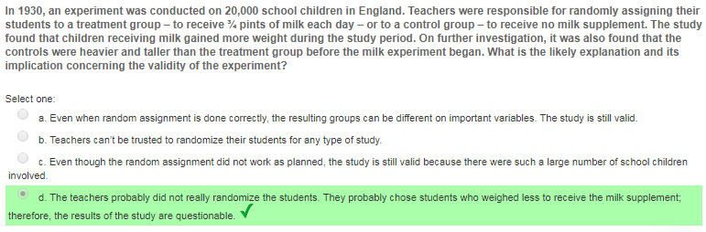
Questions 3 & 4
During times of scarcity, teachers may have behaved altruistically and given the milk to students who appeared smaller (perhaps as a result of malnourishment).

Slide 4
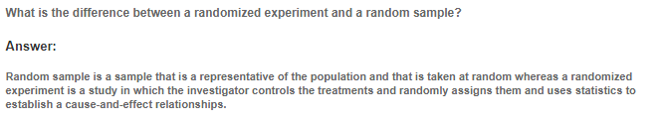
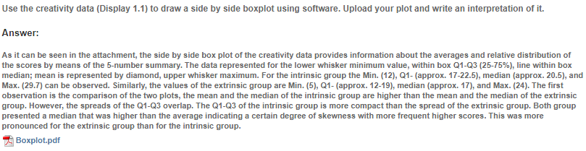
Questions 5 & 6

Slide 5
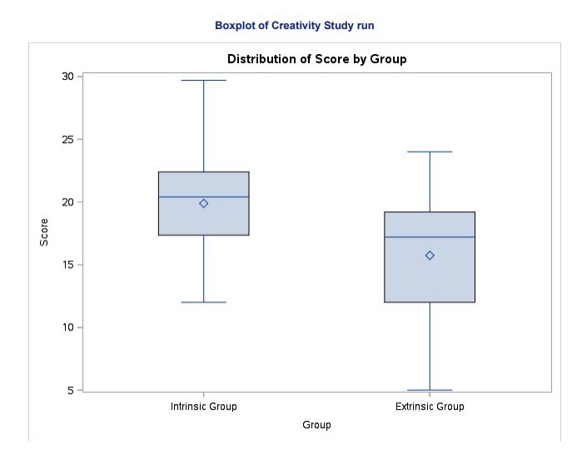
Questions 5 & 6

Slide 6
MSDS 6371: Unit 2
Quiz Solutions

Slide 7
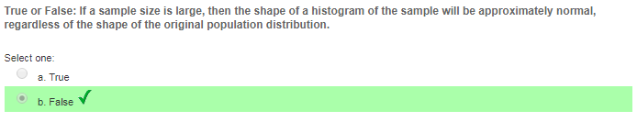
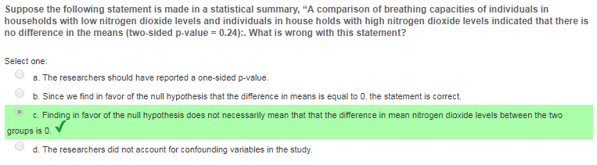
Questions 1 & 2

Slide 8
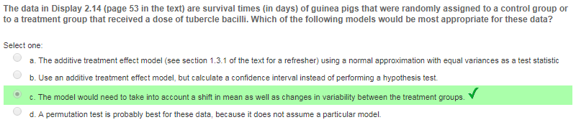
Question 3

Slide 9
MSDS 6371: Unit 3
Quiz Solutions

Slide 10
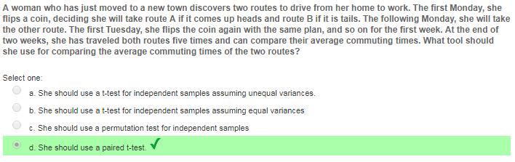
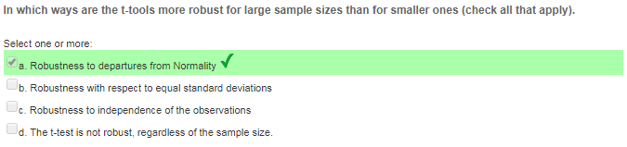
Questions 1 & 2

Slide 11
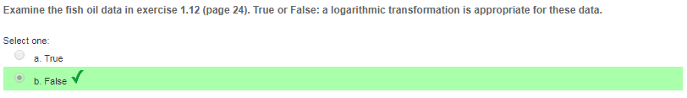
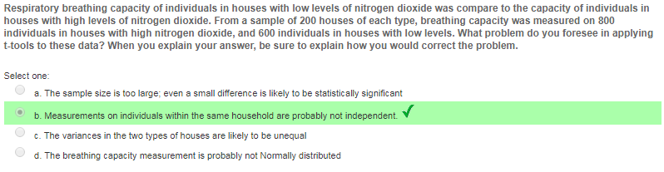
Questions 3 & 4

Slide 12
Quiz 4 Solution

Slide 13
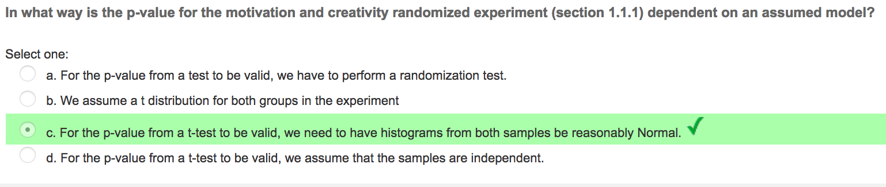
Question 1

Slide 14
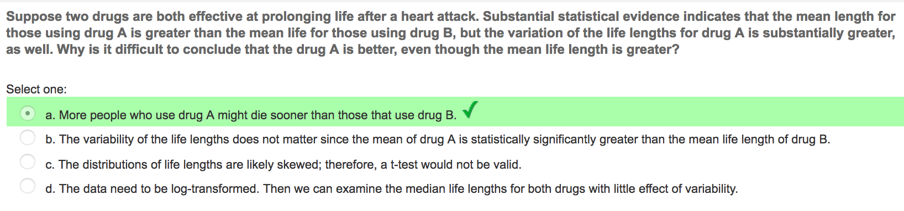
Question 2

Slide 15
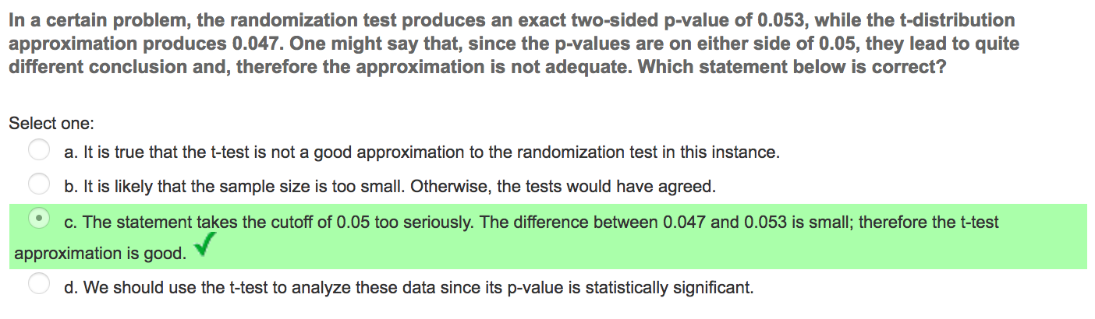
Question 3

Slide 16
Quiz 5 Solutions!

Slide 17
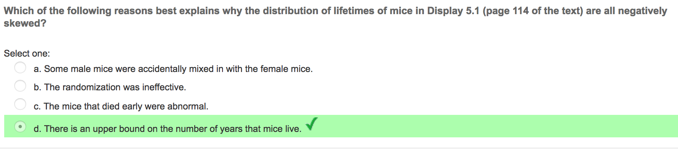
Question 1

Slide 18
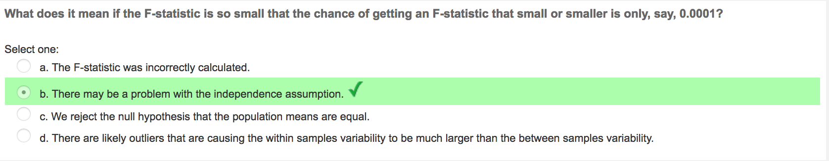
Question 2

Slide 19
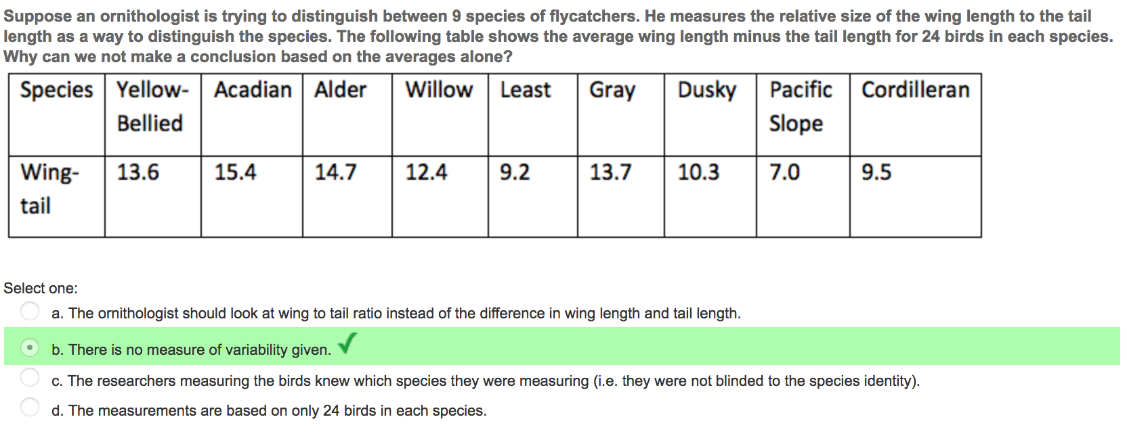
Question 3

Slide 20
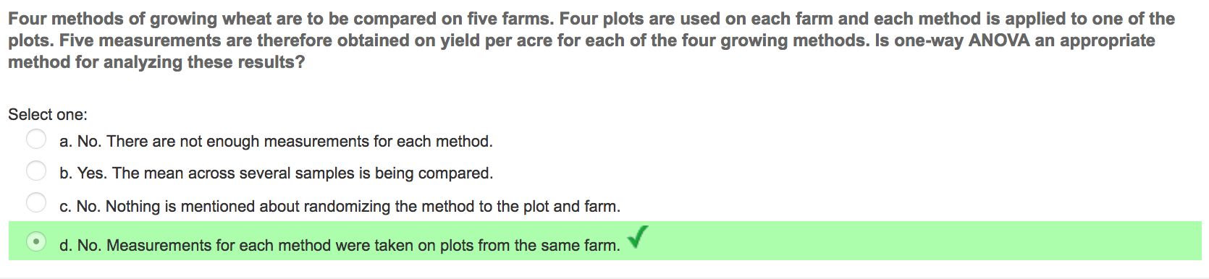
Question 4

Slide 21
Quiz 6 Solutions

Slide 22
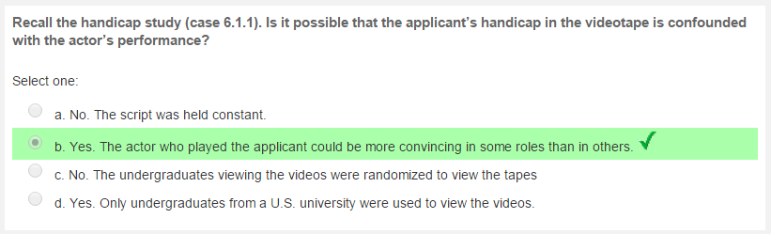
Quiz Question 1

Slide 23

Quiz Question 2

Slide 24
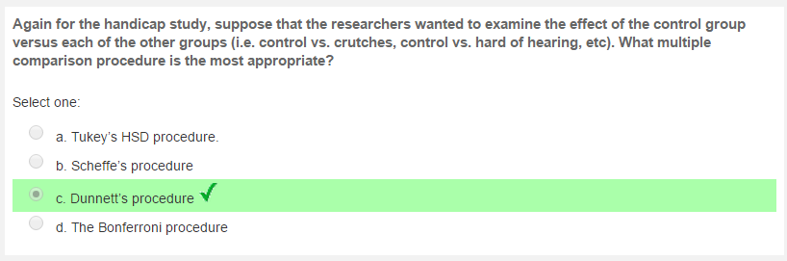
Quiz Question 3

Slide 25
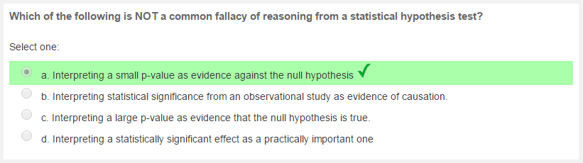
Quiz Question 4

Slide 26
Quiz 8 Solutions

Slide 27
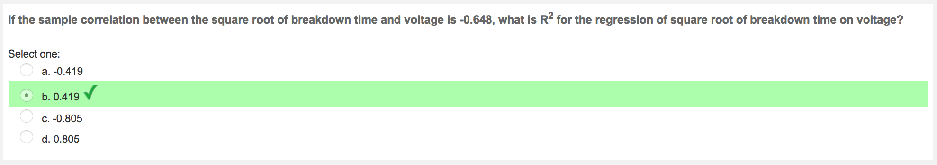
Quiz 8 Solution Q1

Slide 28
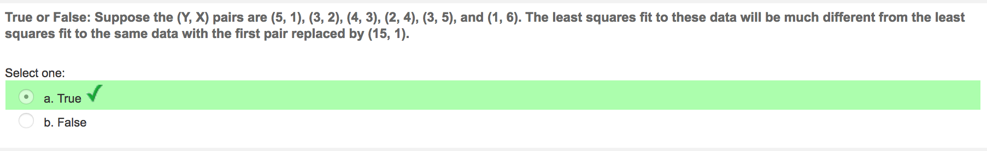
Quiz 8 Solution Q2

Slide 29
UNIT 9
Quiz Solutions

Slide 30
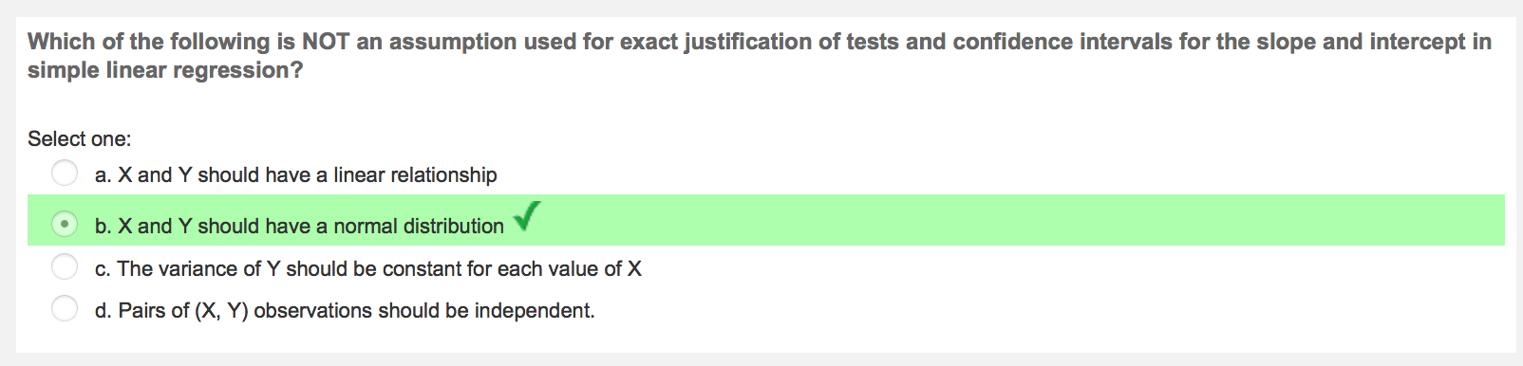
Quiz 9: Question 1

Slide 31
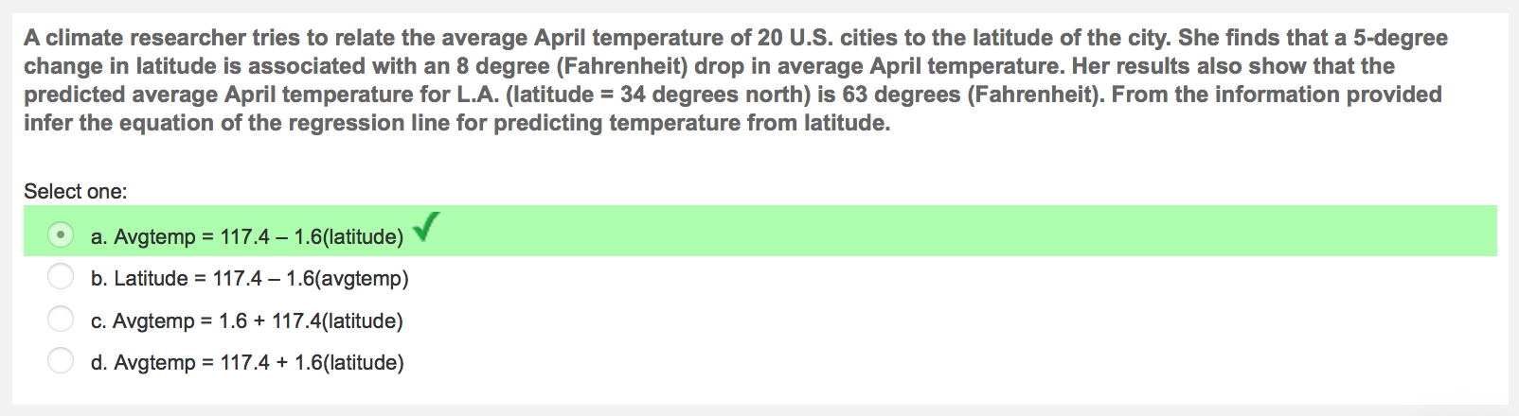
Quiz 9: Question 2

Slide 32
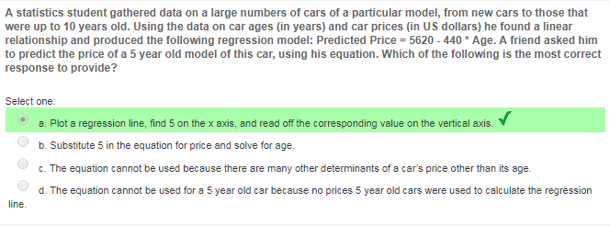
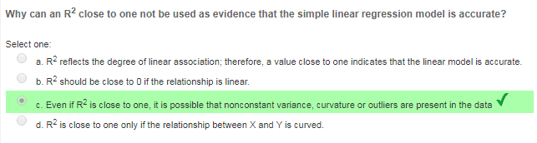
Quiz Solutions

Slide 33
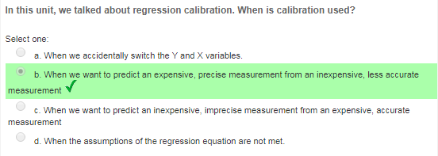
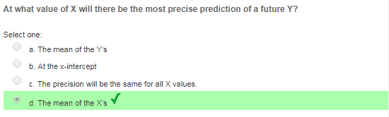
Quiz Solutions

Slide 34
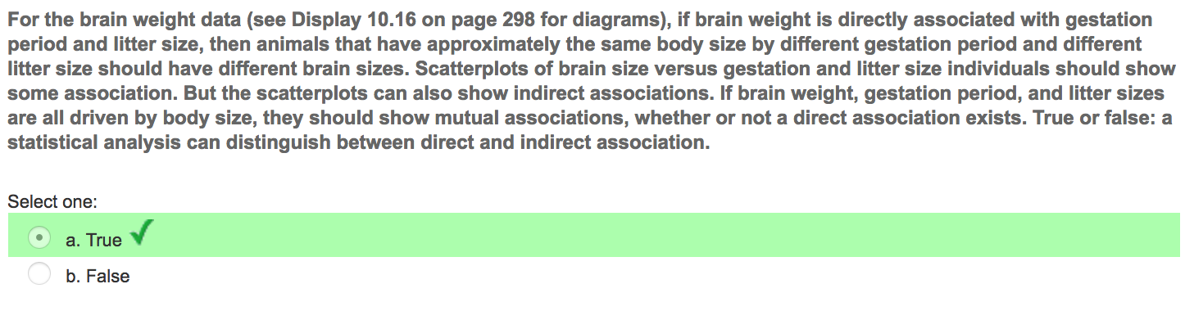

Slide 35
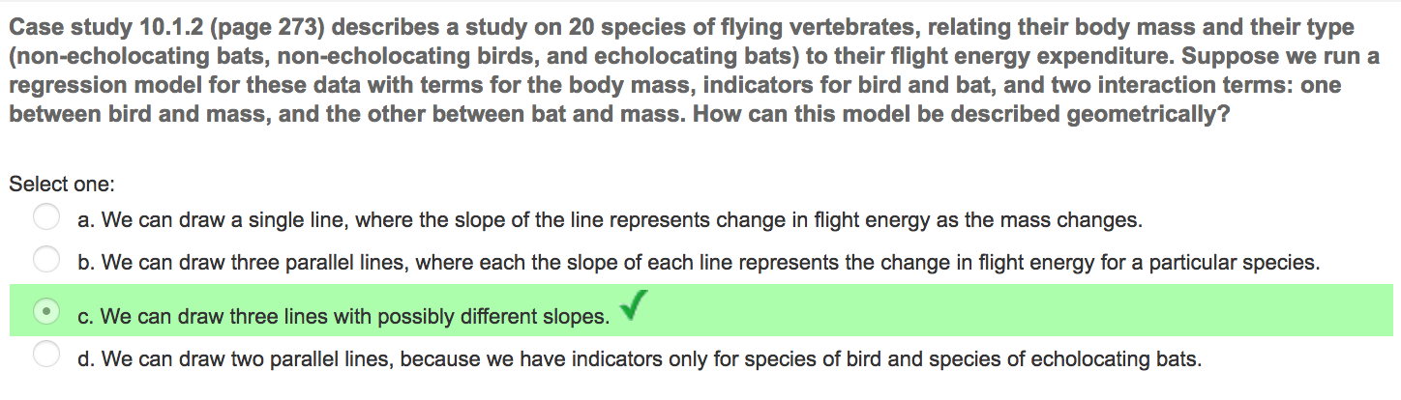

Slide 36
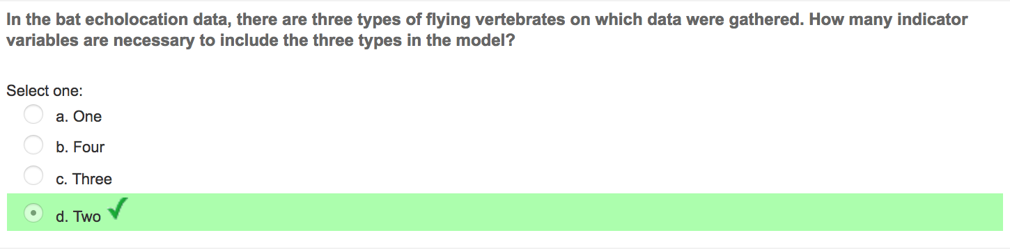

Slide 37
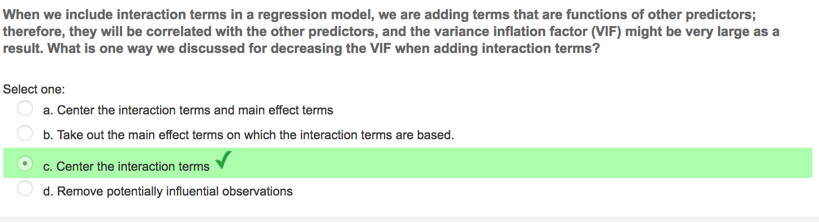

Slide 38
Quiz 13

Slide 39
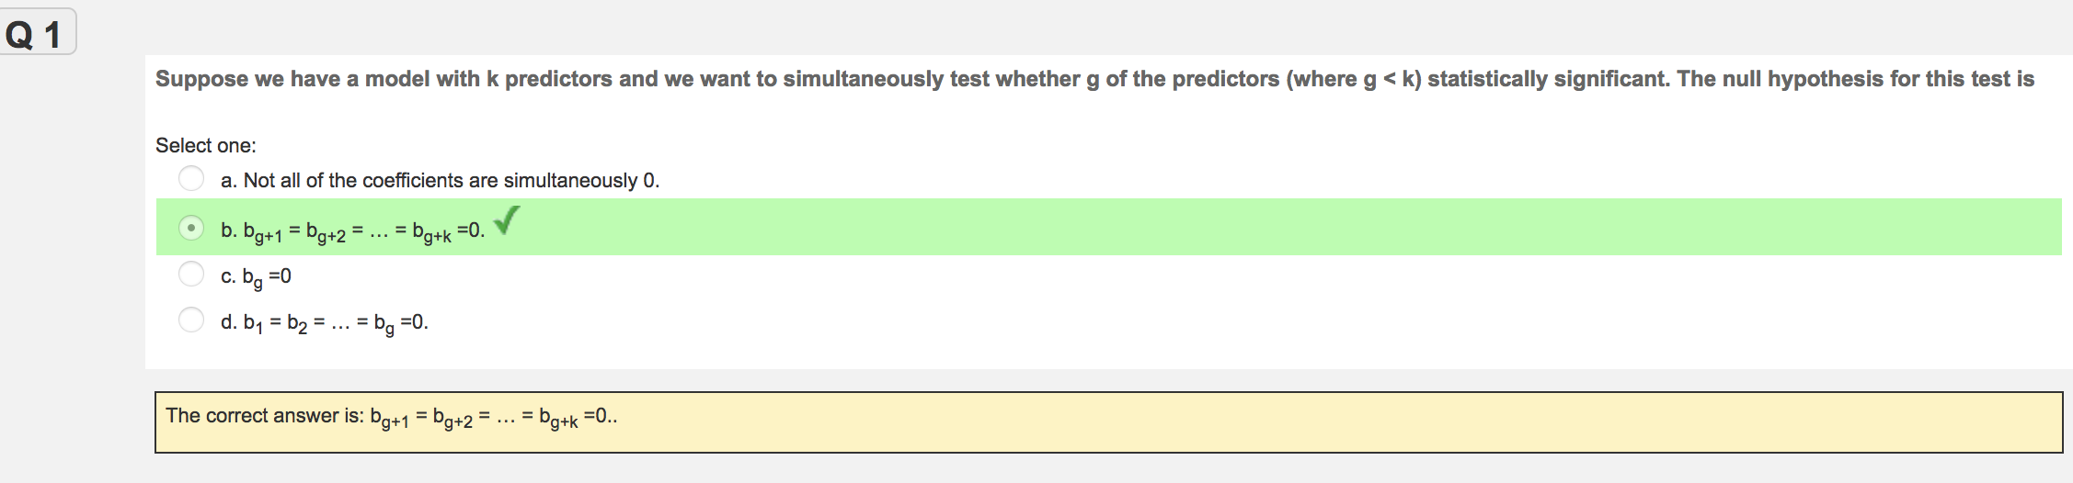
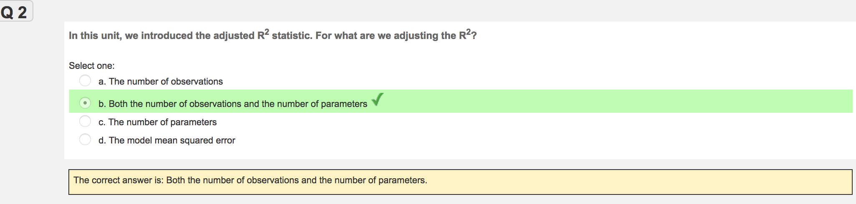

Slide 40
